Slide 1

iClicker – First Day of Class Slides
Note to Instructors:
This presentation deck outlines the steps your students should take to prepare for class if you will be using iClicker Cloud.
Text marked in RED should be changed to better suit your course/campus set-up.

Slide 2
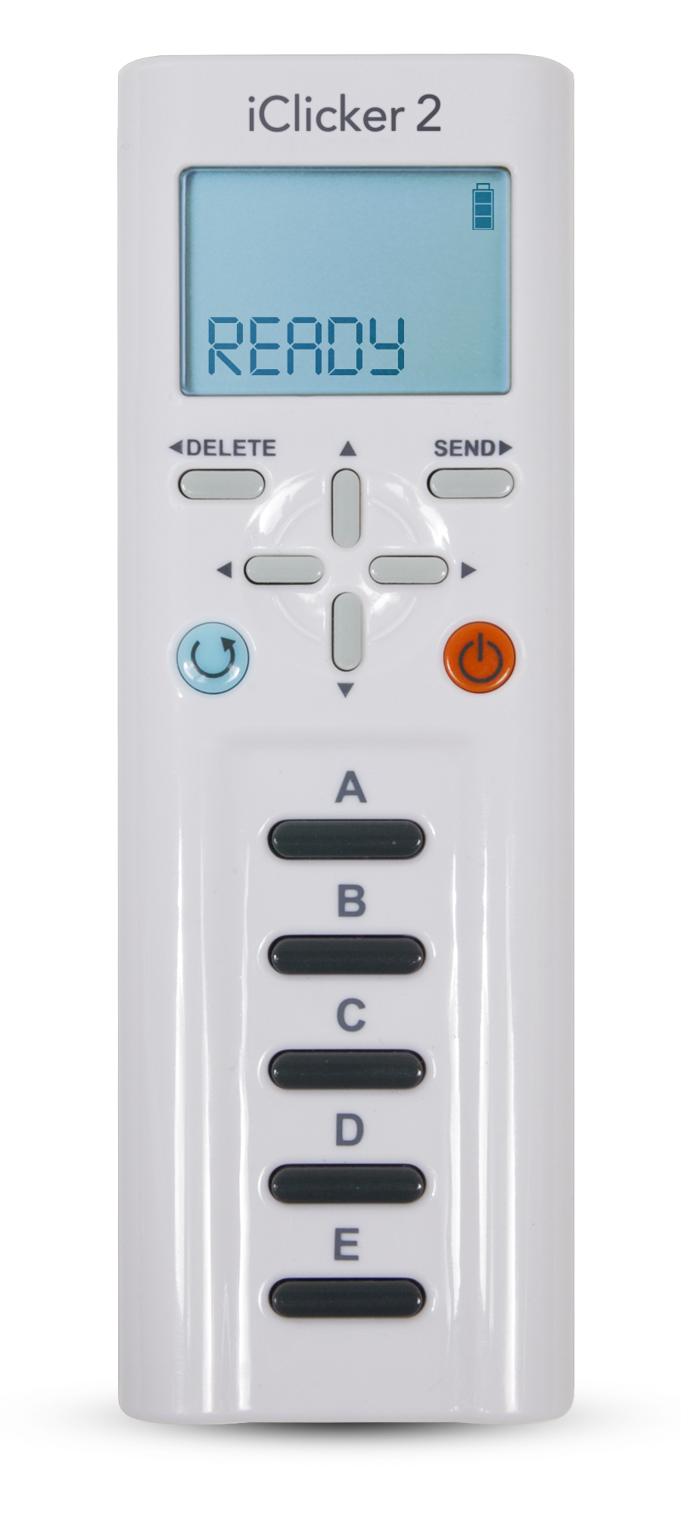
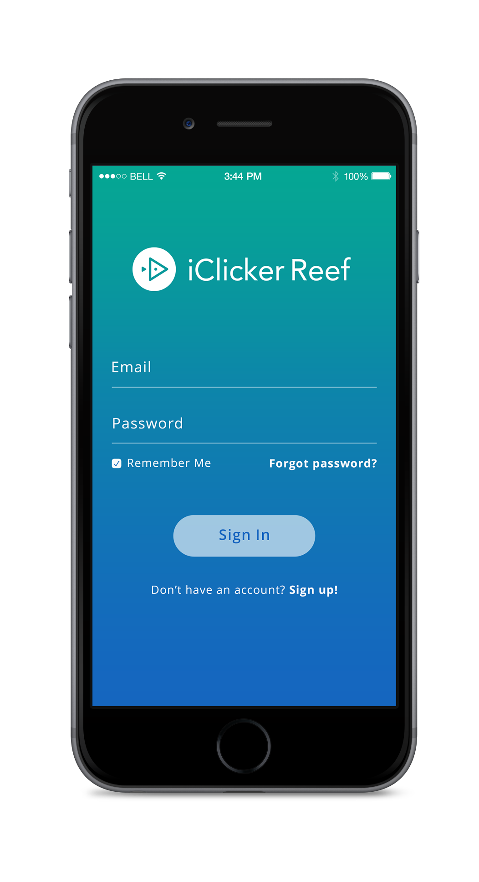
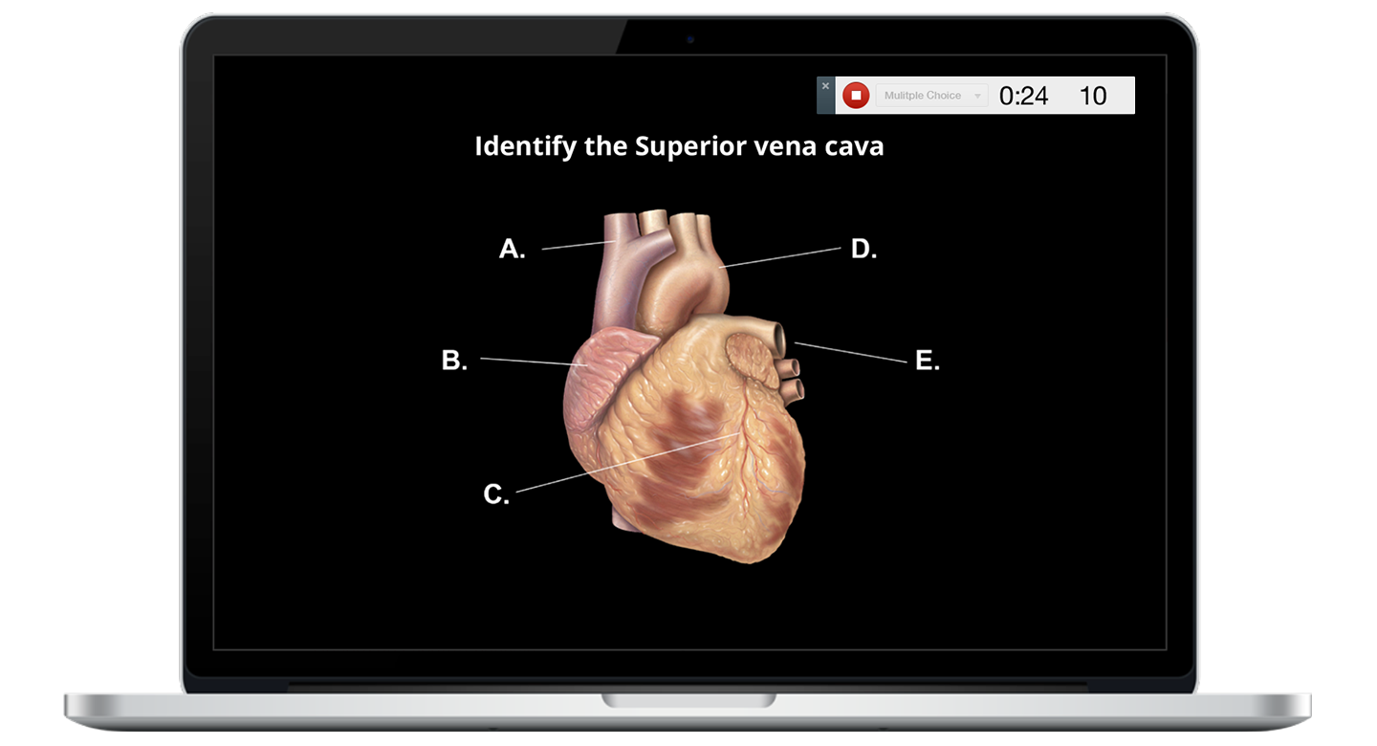
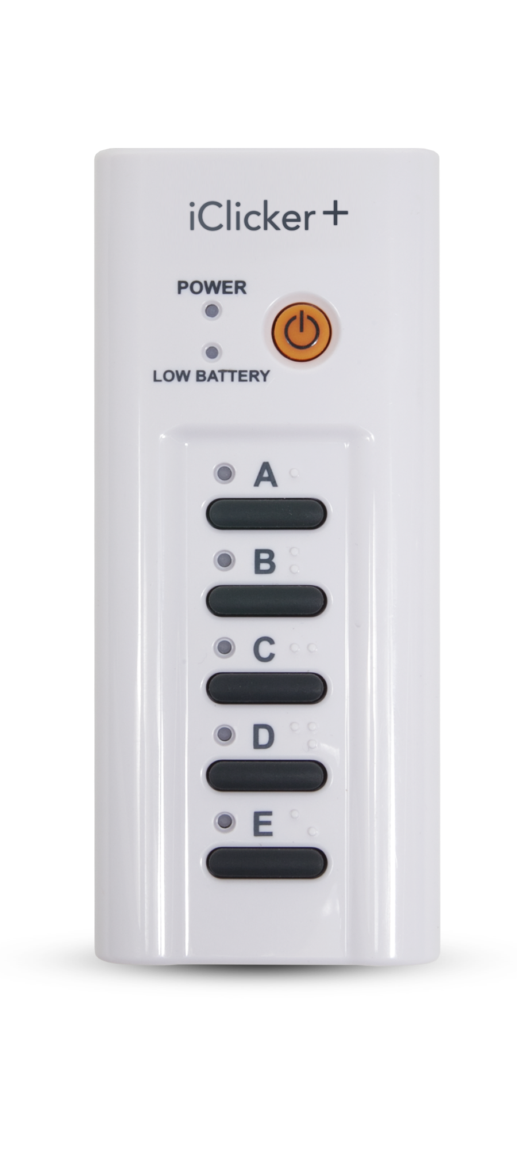
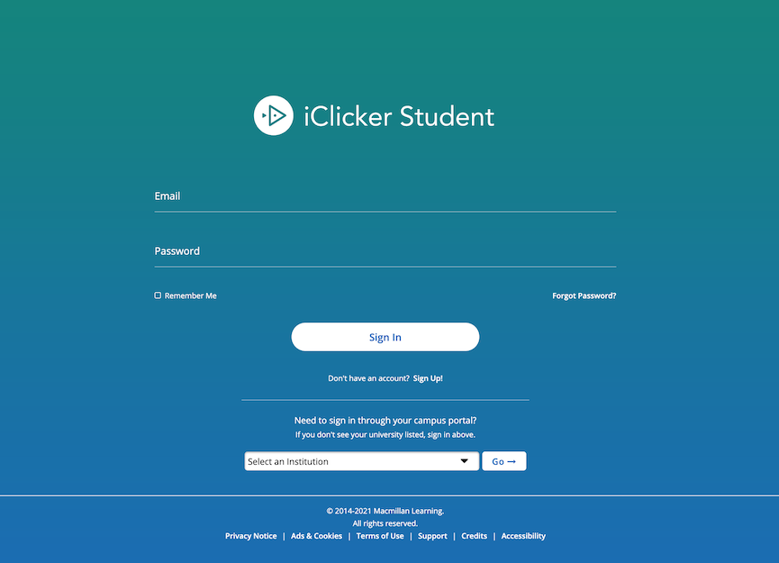
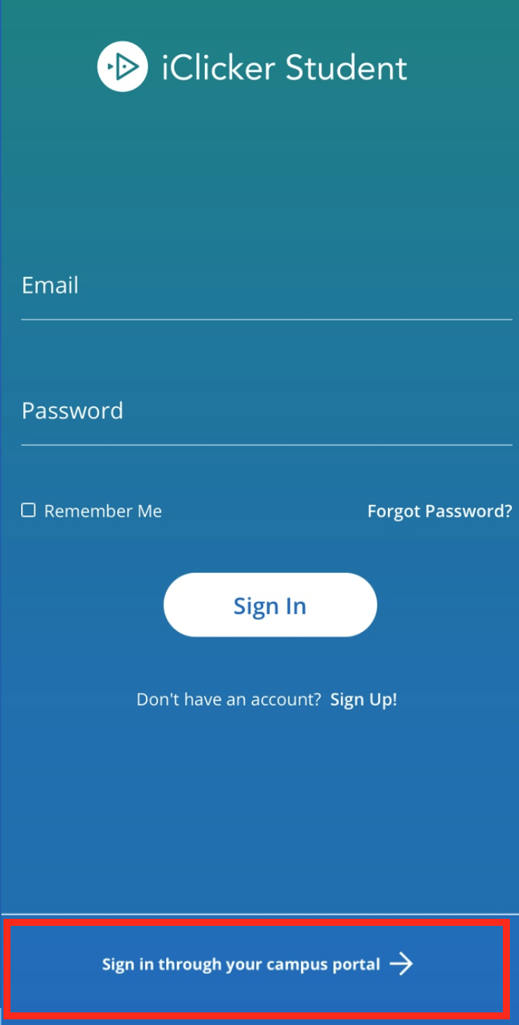
Devices Allowed in Class
You are required to bring a device to participate in my class sessions.
I will be allowing the use of iClicker remotes, the iClicker student app (on a smartphone, tablet or laptop), or both. Please note: no matter what you choose to use you MUST create an iClicker student account to sync your responses to Brightspace. Directions on registering the remote in your iClicker student app profile will be shown in this slide deck.

Slide 3
Navigate to iClicker’s student app
You can use your university account to access the iClicker student mobile or web app (formerly known as iClicker Reef).
If you already have the iOS or Android app, you must first LOG OUT of any account currently logged in.

Slide 4
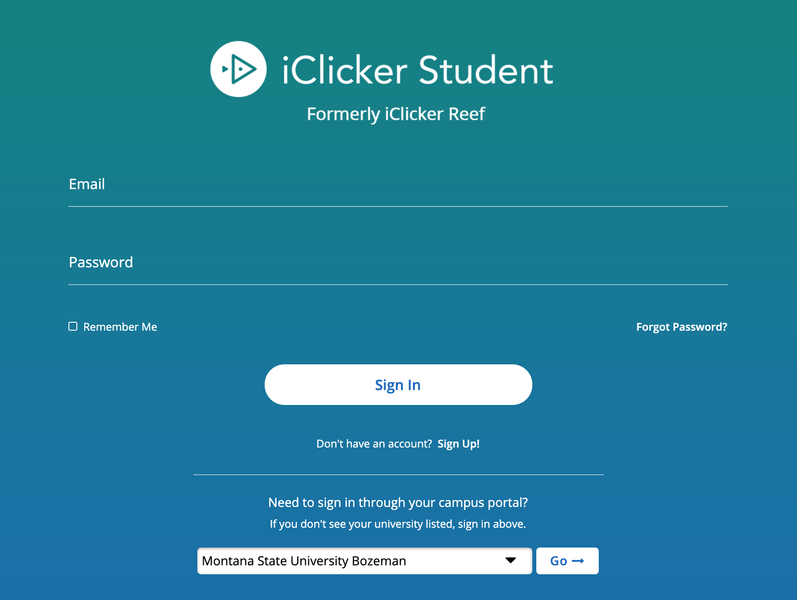
Log in using your Montana State NetID
You will use the bottom portion of the login page to sign in in with your campus account.
Select Montana State University Bozeman from the list, and click the Go button.
Log in to the campus site using your NetID. You will be redirected back to iClicker to finish setup.
You will always log in for class from here using your Montana State NetID.

Slide 5
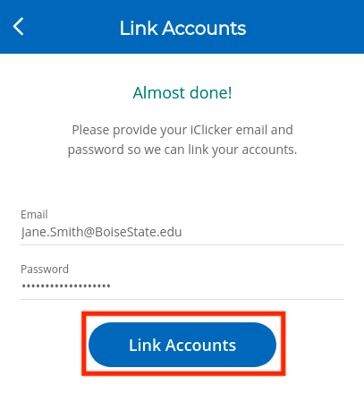
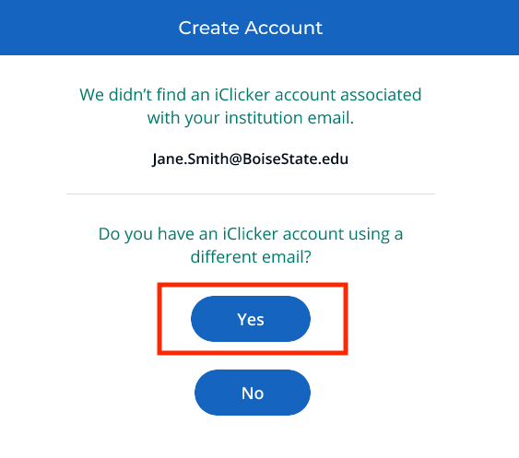
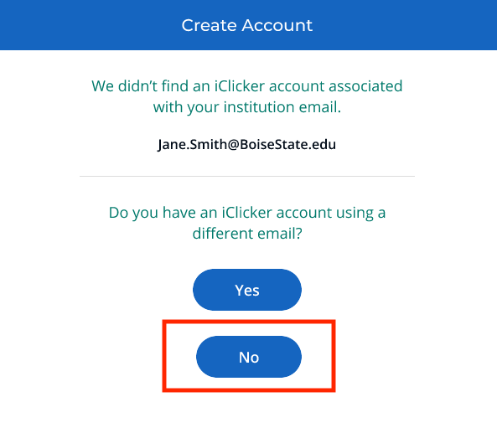
Follow the account setup directions
IMPORTANT: If you already have an iClicker account, do not create a new account. iClicker will attempt to find your account for you.
If an account is found, enter your existing iClicker password. Select Link Accounts to complete setup.
If you have an iClicker account under a different email, select Yes to the question below. Enter your account information to update your account.
If you do not have an Clicker account, select No to the question below, then select Create Account. An account will be set up for you..
firstname.lastname@student.montana.edu
firstname.lastname@student.montana.edu
firstname.lastname@student.montana.edu

Slide 6
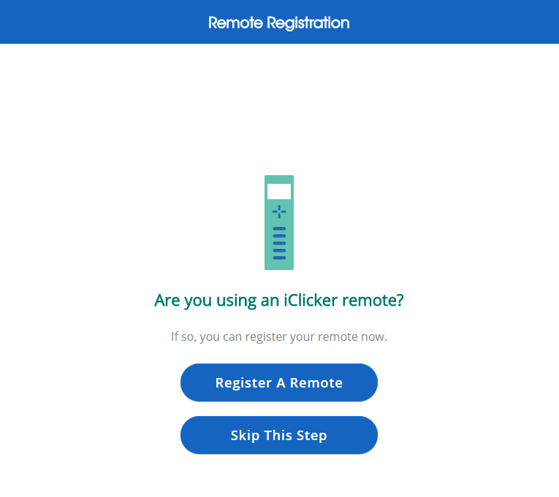
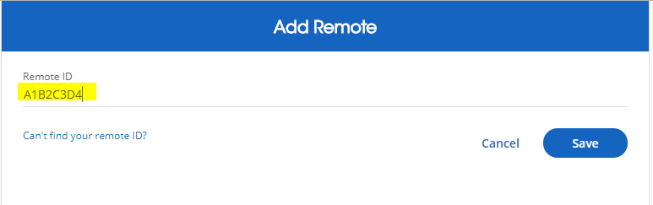
(OPTIONAL): Add your iClicker remote ID
If you plan to use an iClicker remote, you must register your 8-digit iClicker remote ID in your iClicker student account.
The first time you sign into your iClicker student account, you will be prompted to register the 8-digit remote ID found on the back of your remote.
You can also add or update your remote registration at any time through the Menu > Profile section of the app.

Slide 7
Now you’re ready to go!
iClicker Remote Users: Make sure you are connected to my frequency: [AA].
iClicker App Users: When I start a session, you will see a button appear on your screen to Join my class. Click this button to start participating in my session for the day.

Slide 8
Questions or Trouble Registering? Visit iclicker.com/support to submit a support ticket and contact the tech support team.
I have also added these steps and links to helpful troubleshooting guides for iClicker in the syllabus.

